Slide 1
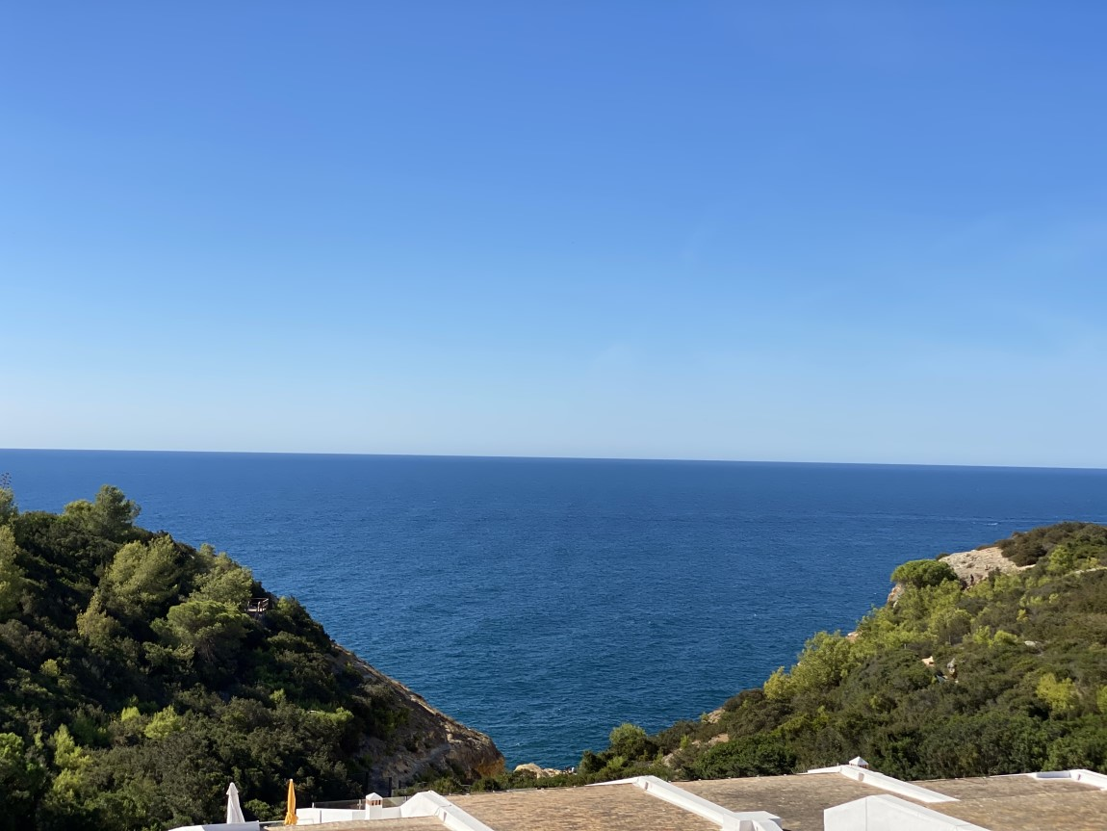
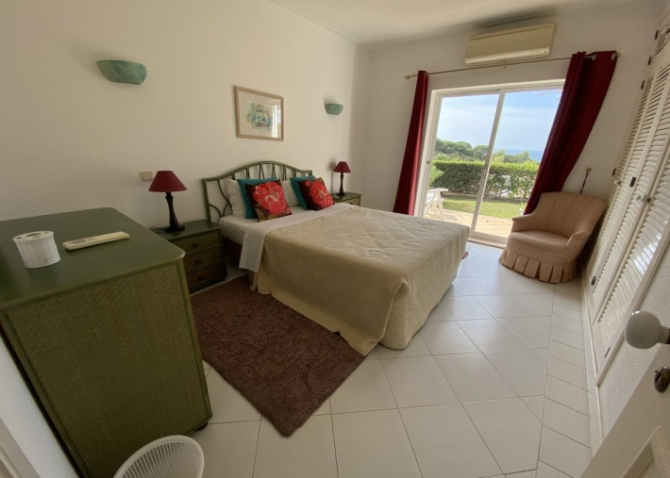
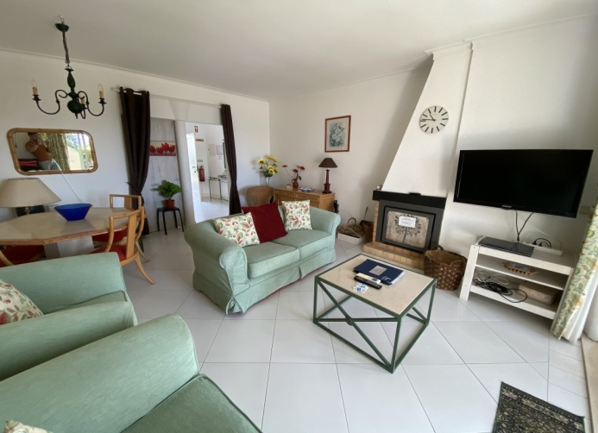
Luxury two bedroom
single storey villa
with good sea views
Reference: OR 305
Entrance hall.
Lounge and dining area with air conditioning and patio doors
onto terrace and garden area with sea views.
Double bedroom with fitted wardrobes, air conditioning
and patio doors to the terrace and garden area with sea views.
Twin bedroom with fitted wardrobes and refurbished en-suite showeroom.
Refurbished family bathroom.
Fully fitted kitchen with door to a drying area and a store room.
Fully furnished.
Outside stairs to large roof terrace with panoramic views
Energy Certificate rating: ‘D’
Constructed Area 90 sqm Terraced Area 26 sqm Roof terrace Area 60 sqm
Annual Condominium 2019: 3.563 €uros
PREÇO / PRICE: £320.000
AMI Licença n.º 7319  APEMIP n.º 3731  Contribuinte n.º 507 757 912
Sala de Vendas  Rocha Brava Apartamentos Turísticos  Apartado 1047  8401 – 908 Carvoeiro LGA  ALGARVE
Tel: (00351) 282 359 533  E-mail: camil6@world.net.pt  www.rochabravaproperty.com

Slide 2
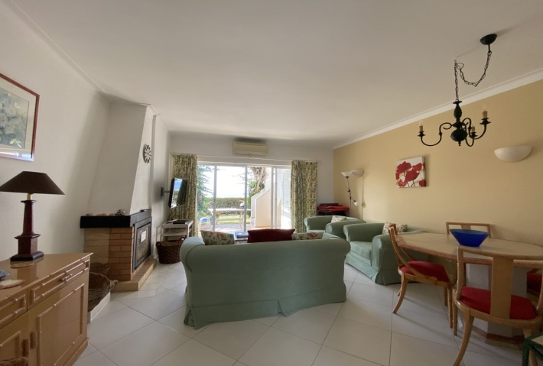
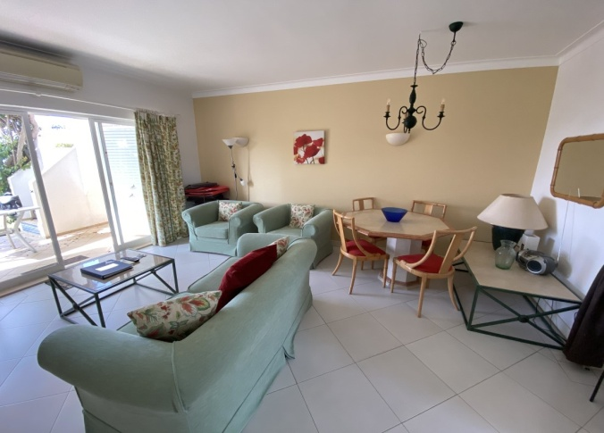
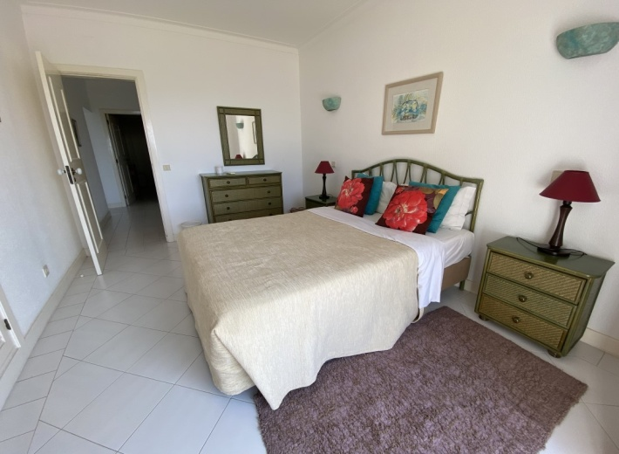
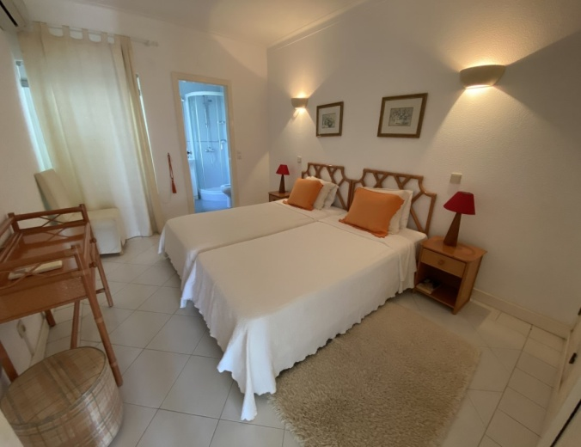
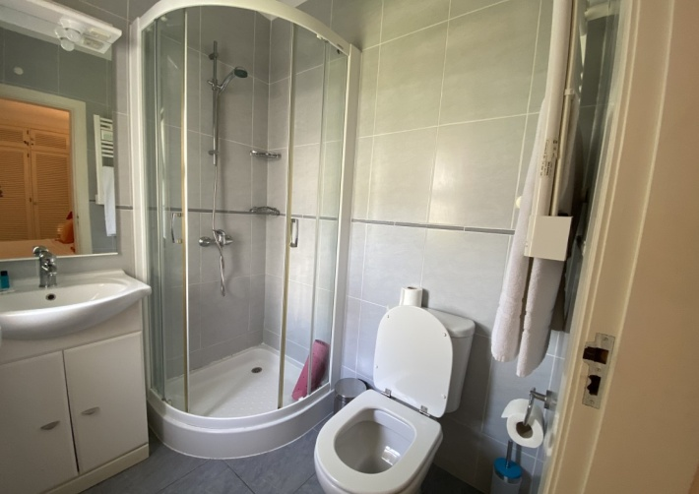
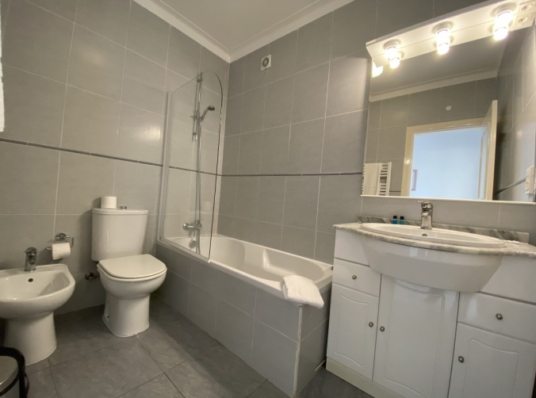
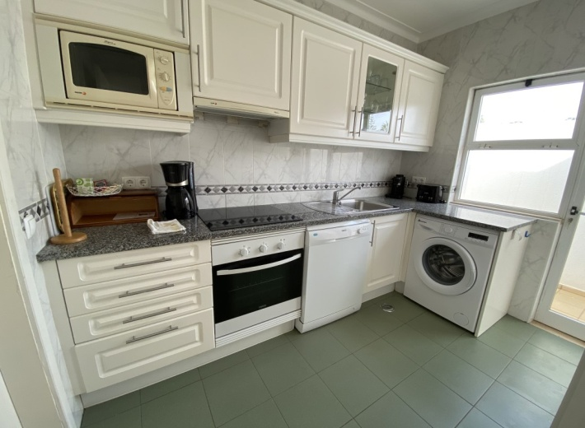
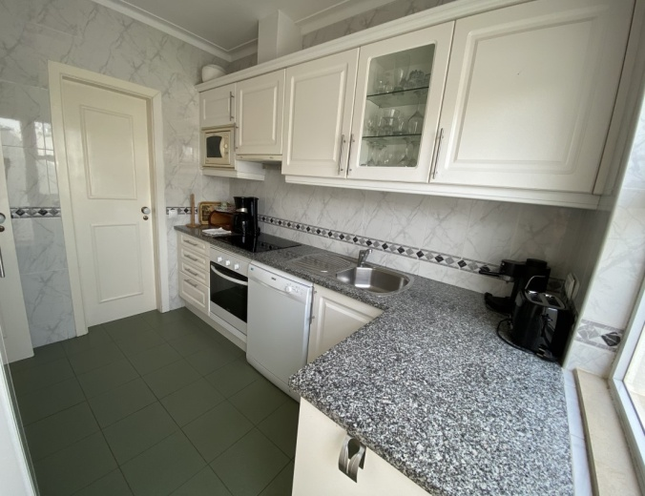
Reference: QS 305
AMI Licença n.º 7319  APEMIP n.º 3731  Contribuinte n.º 507 757 912
Sala de Vendas  Rocha Brava Apartamentos Turísticos  Apartado 1047  8401 – 908 Carvoeiro LGA  ALGARVE
Tel: (00351) 282 359 533  E-mail: camil6@world.net.pt  www.rochabravaproperty.com

Slide 3
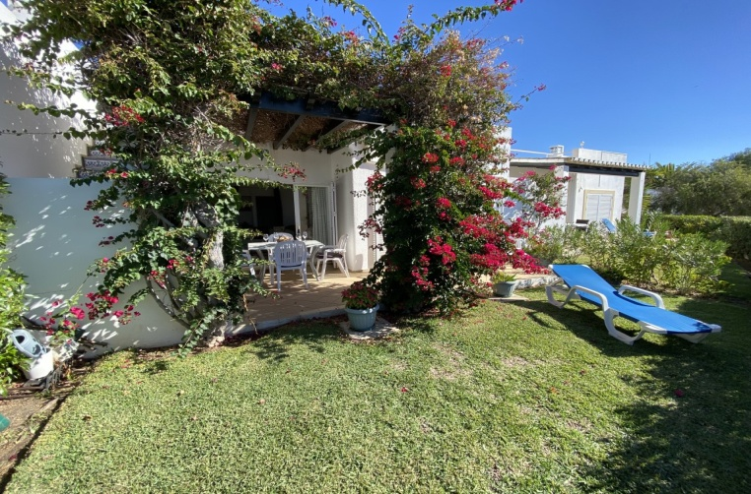
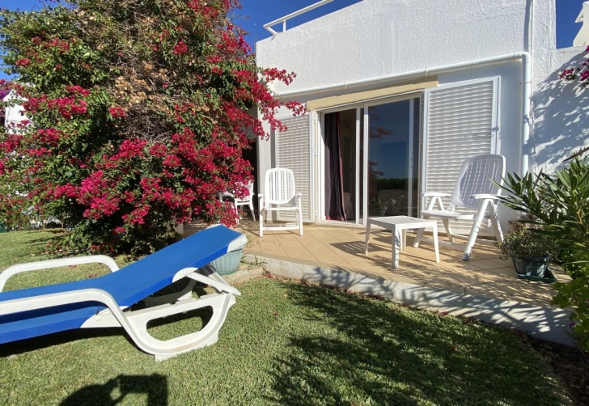
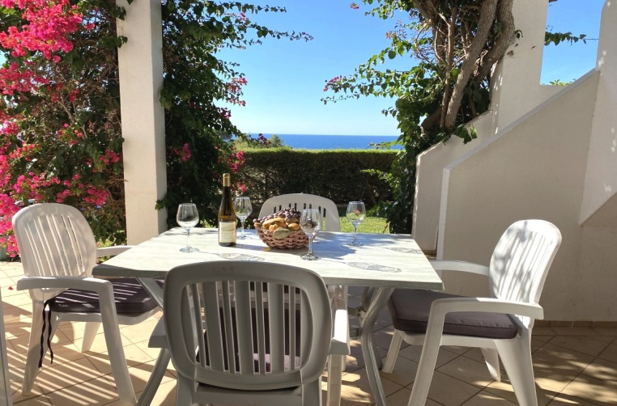
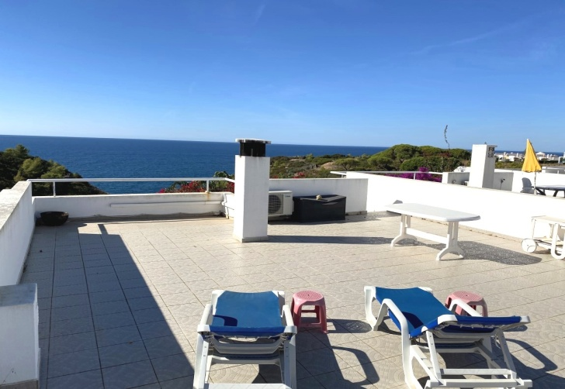
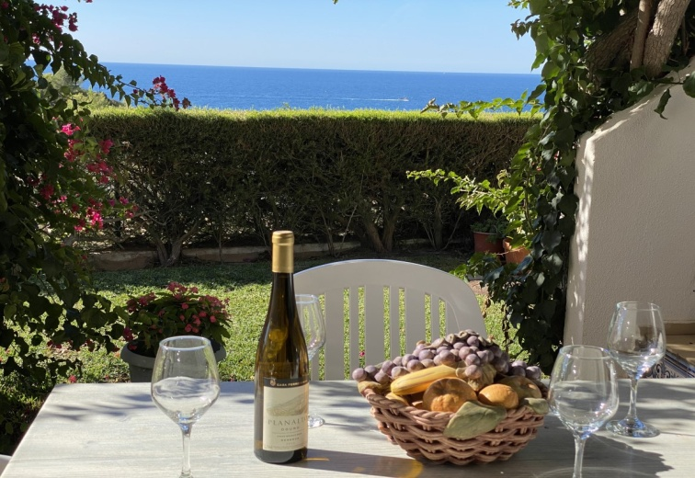
Reference: QS 305
AMI Licença n.º 7319  APEMIP n.º 3731  Contribuinte n.º 507 757 912
Sala de Vendas  Rocha Brava Apartamentos Turísticos  Apartado 1047  8401 – 908 Carvoeiro LGA  ALGARVE
Tel: (00351) 282 359 533  E-mail: camil6@world.net.pt  www.rochabravaproperty.com

