Slide 1
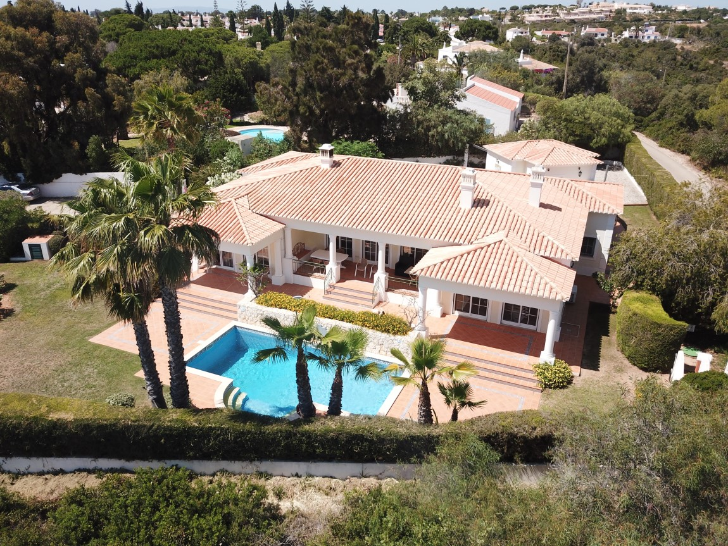
Four bedroom detached villa
with swimming pool and view of the sea from the terrace area
Reference: OR 33
Four bedroom detached villa with private swimming pool,
a view of the sea from the terrace area.
Entrance hall and fitted cupboards.
Double doors to spacious lounge with electric shutters and three twin patio doors
onto terrace, swimming pool with further water feature and gardens.
Separate dining room with electric shutters and patio doors
onto the terrace, swimming pool and gardens.
Master bedroom with fitted wardrobes, air conditioning, en-suite bathroom, electric shutters
and patio doors onto the terrace, swimming pool and gardens.
Second bedroom with fitted wardrobes, en-suite bathroom and air conditioning.
Third bedroom with fitted wardrobes and air conditioning.
Fourth bedroom with fitted wardrobes and air conditioning.
Family walk-in showeroom.
Fully fitted kitchen with island unit and utility room.
Garage, carport and store room.
Gas central heating throughout. Fully furnished.
Energy Certificate rating: ‘D’
Constructed Area 296sqm Plot Area 1,617sqm
Annual Condominium 2021: 6,755 €uros
PREÇO / PRICE: 895.000€ (Sterling Acceptable)
AMI Licença n.º 7319  APEMIP n.º 3731  Contribuinte n.º 507 757 912
Sala de Vendas  Rocha Brava Apartamentos Turísticos  Alfanzina  8400 – 568 Carvoeiro LGA  ALGARVE
Tel: (00351) 282 359 533  E-mail: carvoeiroatlantico@gmail.com  www.rochabravaproperty.com

Slide 2
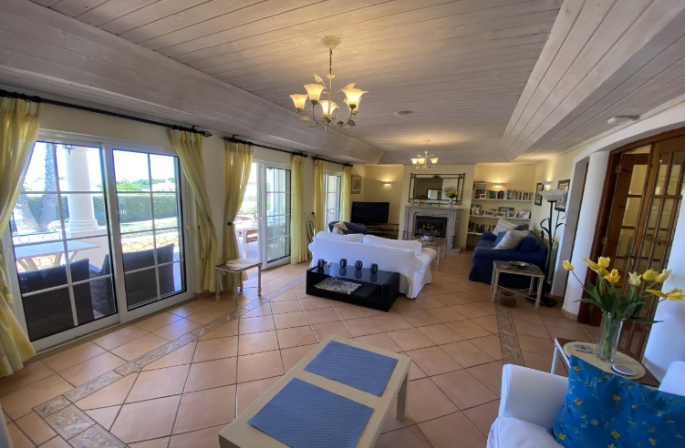
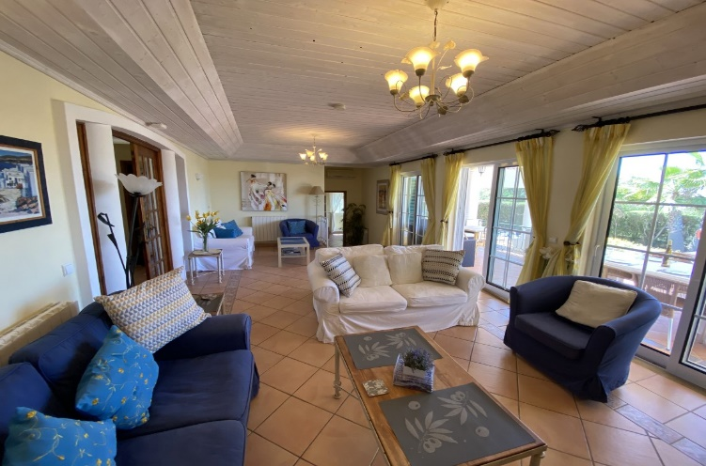
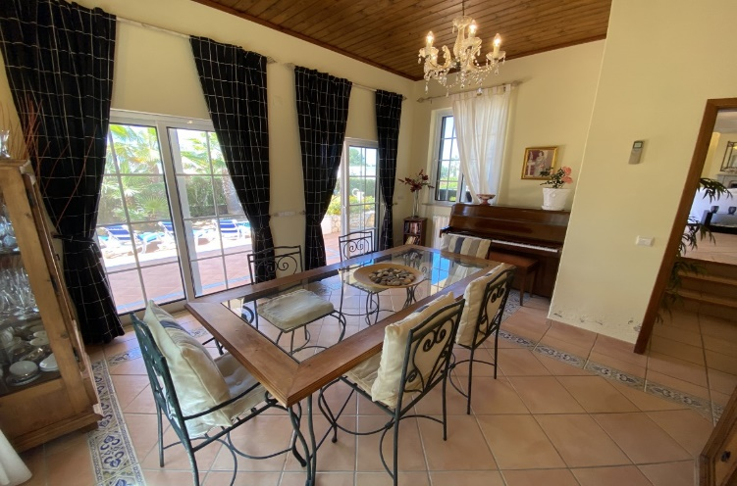
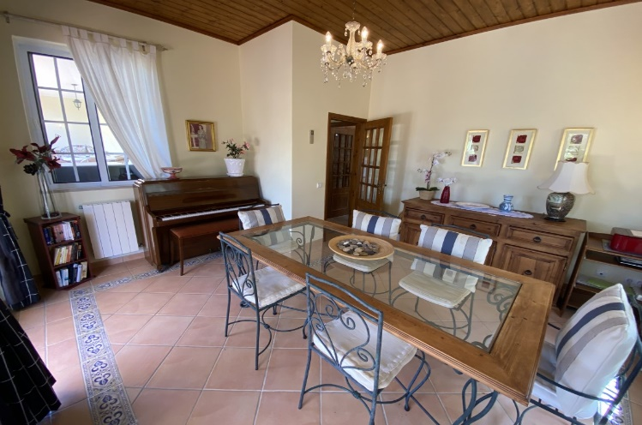
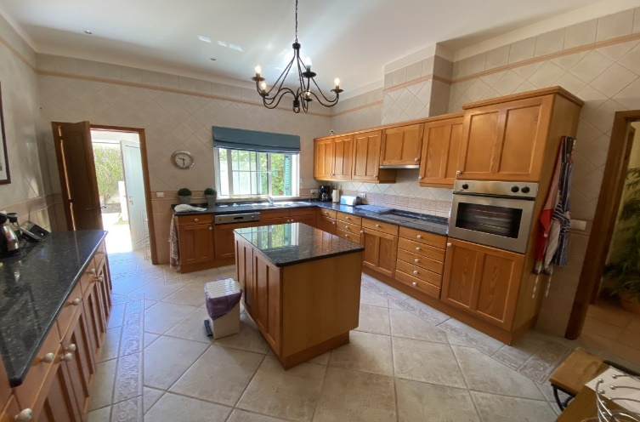
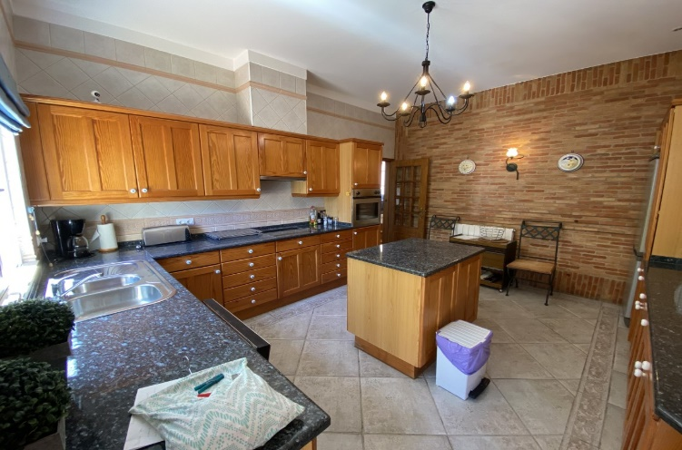
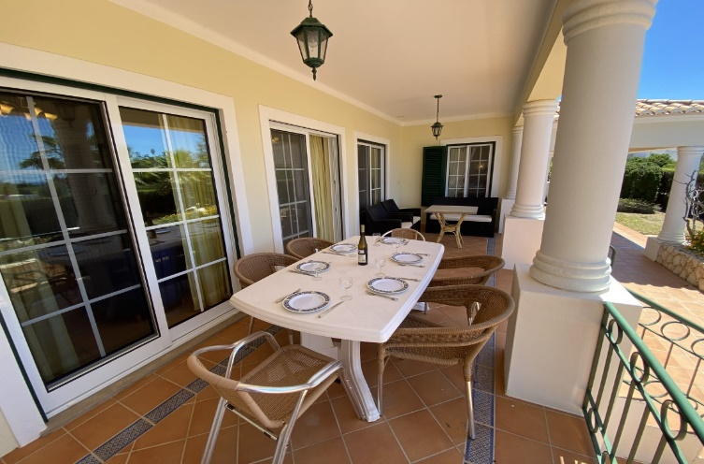
Reference: OR 33
AMI Licença n.º 7319  APEMIP n.º 3731  Contribuinte n.º 507 757 912
Sala de Vendas  Rocha Brava Apartamentos Turísticos  Alfanzina  8400 – 568 Carvoeiro LGA  ALGARVE
Tel: (00351) 282 359 533  E-mail: carvoeiroatlantico@gmail.com  www.rochabravaproperty.com

Slide 3
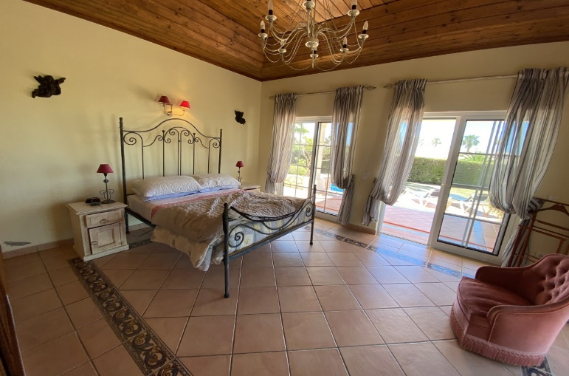
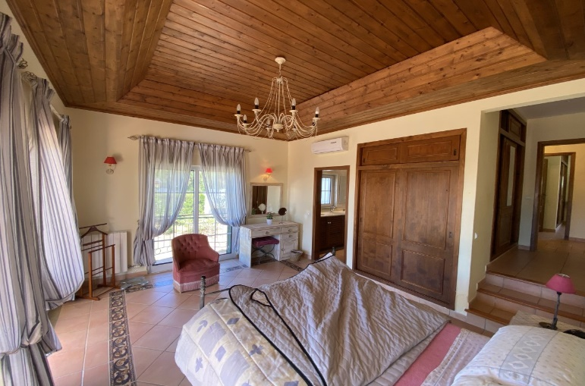
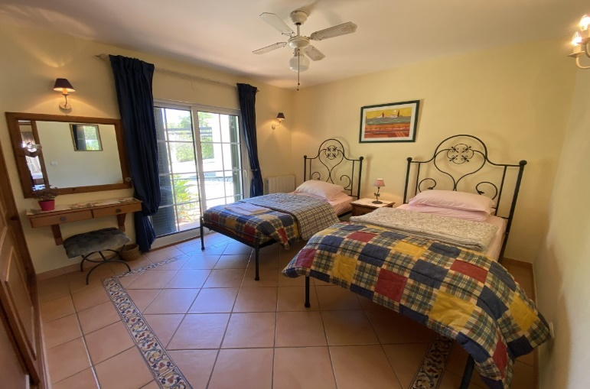
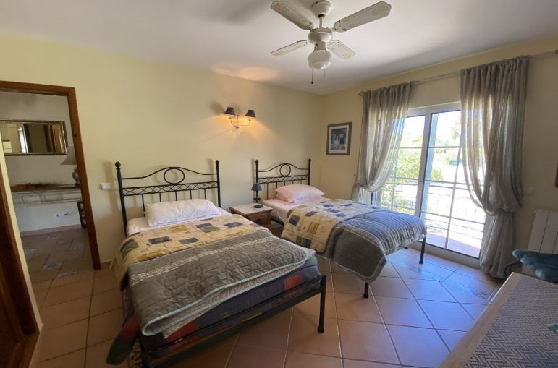
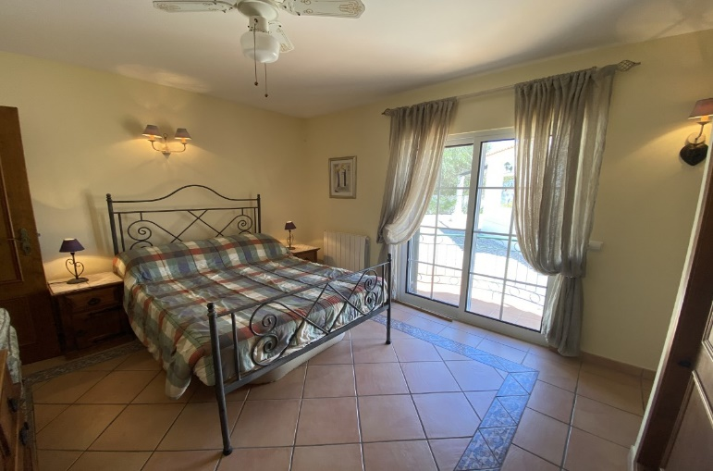
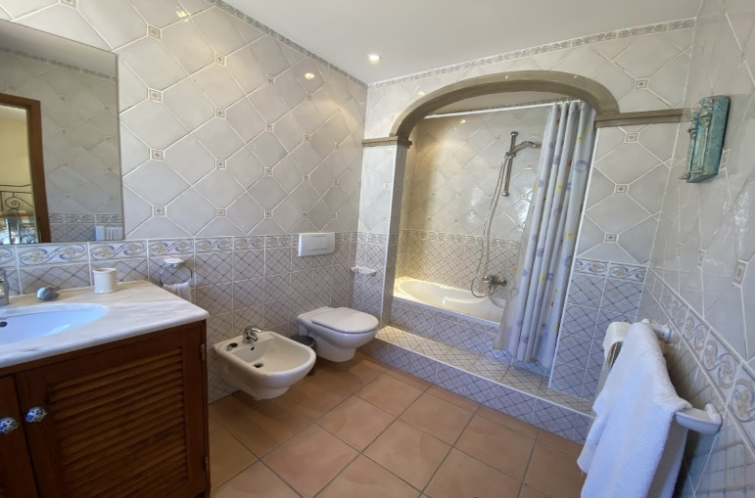
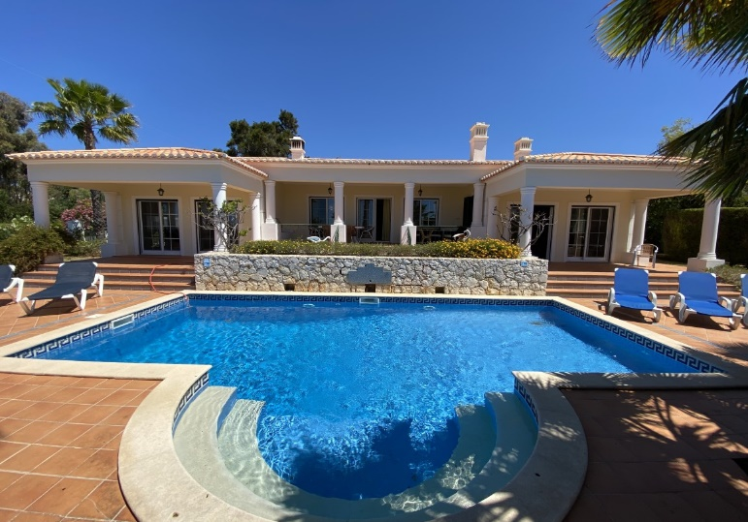
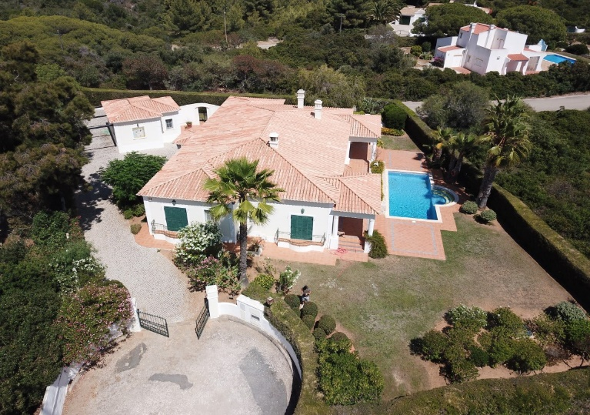
Reference: OR 33
AMI Licença n.º 7319  APEMIP n.º 3731  Contribuinte n.º 507 757 912
Sala de Vendas  Rocha Brava Apartamentos Turísticos  Alfanzina  8400 – 568 Carvoeiro LGA  ALGARVE
Tel: (00351) 282 359 533  E-mail: carvoeiroatalntico@gmail.com  www.rochabravaproperty.com

